Slide 1
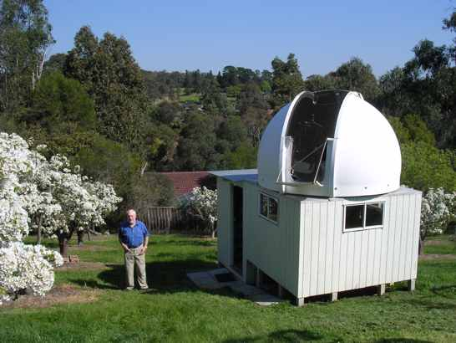
Variable Star Photometry with MaxIm™
Slides to accompany a full-day hands-on computer workshop using MaxIm-DL
Conducted by Dr Tom Richards
Woodridge Observatory
Melbourne, Vic, Australia
Notes:
www.woodridgeobsy.org
tom@woodridgeobsy.org

Slide 2
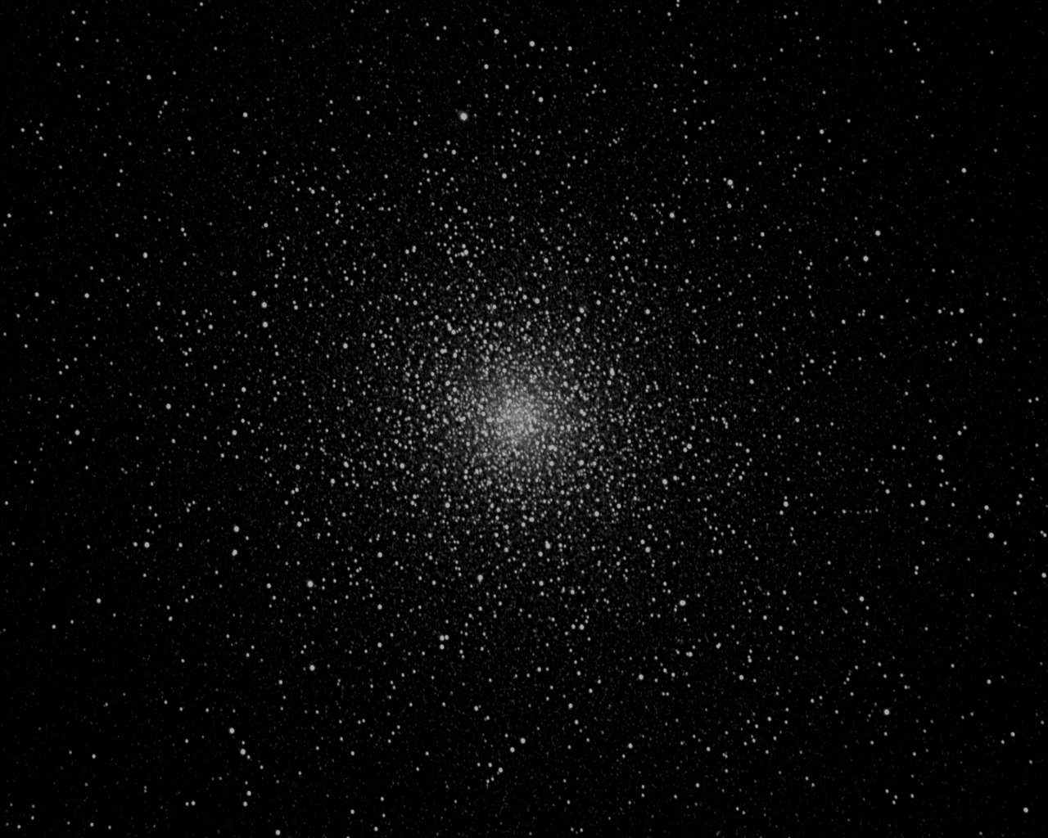
What will you learn about?
Instrumentation and software for photometry
Principles of photometry
What’s involved in imaging for photometry
Noise and how to minimise it
Taking calibration frames
Taking time-series images
The process and results of photometry
Who wants your results?
Who wants you to observe what?
Notes:
Background image is NGC104 (47 Tucanae). 20 sec exposure, Woodridge Observatory.

Slide 3
What will you do in this workshop?
Set up the MaxIm software and data images on your computer
Explore and assess images
Pretend to take a night’s series of images
Assess and calibrate a series of raw variable-star images
Do photometry on the calibrated image series
Investigate the results.

Slide 4
What should you have with you?
Your personal laptop with a CD drive and running Windows™ - preferably XP
Installed software: Word™
The workshop CD
A tutorial manual showing these slides
Pen and paper and calculator.

Slide 5
Setting up MaxIm
Put the workshop CD into your CD drive and open the file How to Install MaxIm.txt.
Follow the instructions in that file to install MaxIm onto your computer and license it.
At the end of all that, leave MaxIm running.

Slide 6
Setting up the data files
From the CD, put the folders Raws, Cal frames and Calibrated onto your desktop.
You’re now ready to start work; but first, some background.
Notes:
Raws contains 100 raw images of the variable star VW Hydri, taken at Woodridge Observatory on 2005.12.05, using a 180 mm f/9 Astro-Physics refractor (since sold). The camera is an SBIG ST7, 768 x 512 pixels, image scale 1.14"/px. (see later for the significance of this information.)
Cal Frames contains three calibration frames that will be use to remove various errors in the raw star images.
Calibrated is empty.

Slide 7
Equipment for Photometry
We will now look briefly at these items:
  Telescope
  Mounting
  Housing
  Camera
  Guiding equipment
  Computer
  Software

Slide 8
Equipment item 1: Your telescope
8-inch scope or better, optical quality not important
Rigid tube and mount for camera
Use anti-dewing heaters if necessary

Slide 9
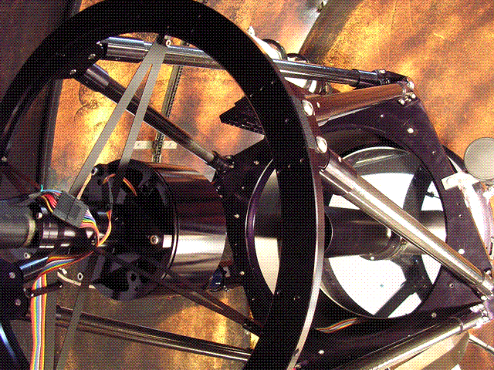
This is Woodridge Observatory’s 0.4 m RCOS Ritchey-Chrétien telescope
Notes:
Mirror diameter D = 0.406 m
Focal length F = 3.380 m
Focal ratio = 8.32

Slide 10
Viewing the Field
Eyepiece viewing is important for aligning the scope on the stars, checking what’s in the field of view, estimating seeing conditions etc., as well as for the pleasure of looking.
A CCD camera is like a high-power eyepiece – terrible for finding objects
So you need a reliable large-aperture guide scope or a flip/slider mirror in front of the camera.
Notes:
Typical field width of a CCD camera = 15 arcmin (half Moon’s diameter)
With a flip mirror or mirror slider you can leave the camera permanently mounted, but you can still look through the eyepiece

Slide 11
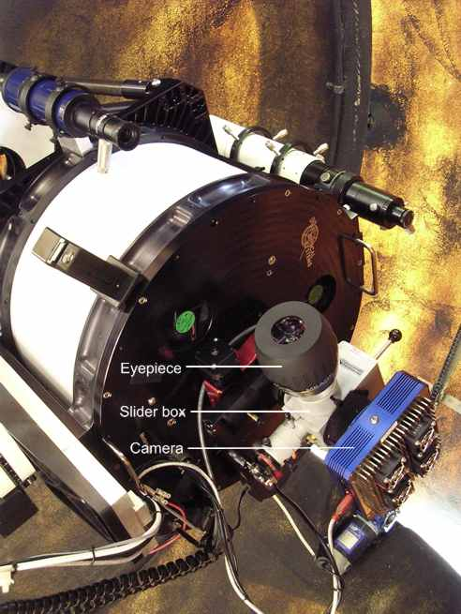
WO uses a Van Slyke Slider immediately before the camera to divert the image to an eyepiece.

Slide 12
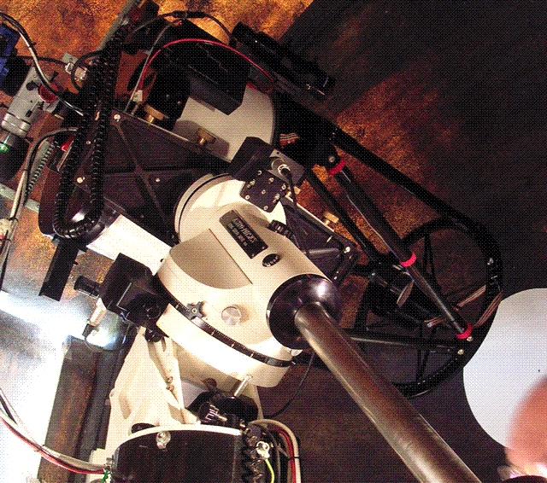
Equipment item 2: Your mounting
Put your money into the mount:
Equatorial or alt-azimuth head
Rigid pier or tripod, or firm Dob base
Accurate drive, with periodic error control
Go-to capability can save delay
Capability to be controlled by a computer is useful.
Notes:
If you have an alt-az mount (e.g. a Dobsonian) you do not need an image rotator. You just keep your exposures short enough so the stars don’t show field rotation trails.
If you don’t have a good accurae drive, you can still do snapshot imaging instead of time-series. This involves one image of a star per night, or a few well spaced out. So do many stars per night. Then typically you repeat on the stars on other nights. Suitable targets are long-period variables. With snapshot work it’s very often desirable to use filters (the Johnson-Cousins UBVRI set) and take images through two or more filters – typically B and V, or V and I.
If you can find target star fields quickly by star-hopping, then Go-to is not important. But variable fields are often unremarkable and star-hopping can take time. Of course, if you’re doing time series, once you’ve found your field that’s it for the night – or until you do a meridian flip!
Computer control is great but not necessary. I use TheSky from Software Bisque (so I can click on a star in the planetarium display and tell the scope to go there). Simultaneously I can use MaxIm’s telescope control facilities, and the MaxPoint program which learns and corrects for telescope pointing errors.

Slide 13
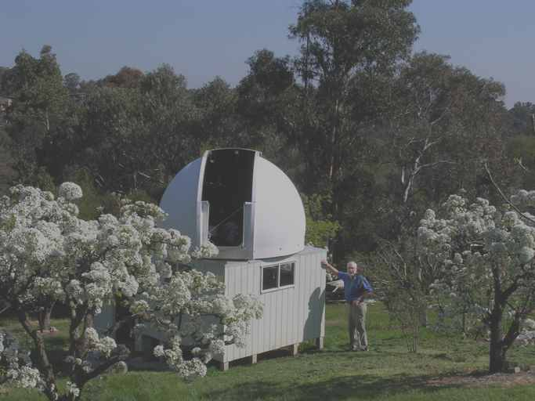
Equipment item 3: Your Housing
Protection for the scope and mount from wind and dewing through a long night!
  Shed with slide-off roof, or dome
Shelter for computer, gear and you
  A “warm room” is ideal, or control from your house.
  But remember, you don’t have to be with the scope all night – it will run automatically.
Notes:
Wind can wreck an image.

Slide 14
Summary so far
Minimum requirements:
200 mm scope with rigid camera mount
Strong smooth mount with good drive
Housing that provides good shelter.
Coming up:
Camera, guiding, computer and software;
Handling images in MaxIm.

Slide 15
Equipment item 4: Your CCD Camera
We’re talking here about astronomical CCD cameras
  Video cameras and ordinary digital cameras are not suitable for photometry
Even cheap astronomical CCD cameras can do a fine job
There’s lots to know here before you buy…
Notes:
Dr Arne Henden (Director, American Association of Variable Star Observers) favourably reviewed the (relatively!) cheap Meade DSI camera for variable star work, in Sky & Telescope, October 2005, p.79.
Matching scope to camera: as we’ll explain, the width of a pixel aka photosite on your camera needs to be about the same as the width of one arcsecond at the prime focus of your telescope. Typically these are measured in microns µ (10⁻⁹ m).
WO uses an Apogee U13 camera.

Slide 16
Some camera purchasing tips
Look for a thermostatically controlled cooler – very desirable
Avoid colour cameras – mandatory!
Preferably, avoid cameras with anti-blooming gates
Look for fast download times, say 2 s. (USB2 is the way to go).
You do need a camera that “matches” your scope – as we’ll explain.
Notes:
Most cameras have electro-thermal coolers (Peltier coolers) with a thermostat. Image noise is very sensitive to temperature, so you want to cool as far as possible and keep it within half a degree (at most) of the set temperature. Convective cooling can be a real problem unless the ambient temperature is stable.
Colour CCD cameras have little coloured masks over the photosites in groups of three. This means the photosites are less sensitive, the resolution is coarser, you can’t use photometric colour filters because the colour sensitivity is trashed, and anyway photometry becomes very imprecise.
Anti-blooming gates (ABG) are devices on each photosite to stop elecrons spilling from a nearly-full photosite into adjacent ones – called blooming. It shows as linear streaks emanating from near-saturated stars vertically down a pixel column. That’s great, but it forces non-linearity to set in much earlier, like at 50% saturation instead of maybe 80%. So the camera is usable for photometry, but with a much reduced dynamic range. Camera models without ABGs are often labelled NABG – double negative Non Anti!

Slide 17
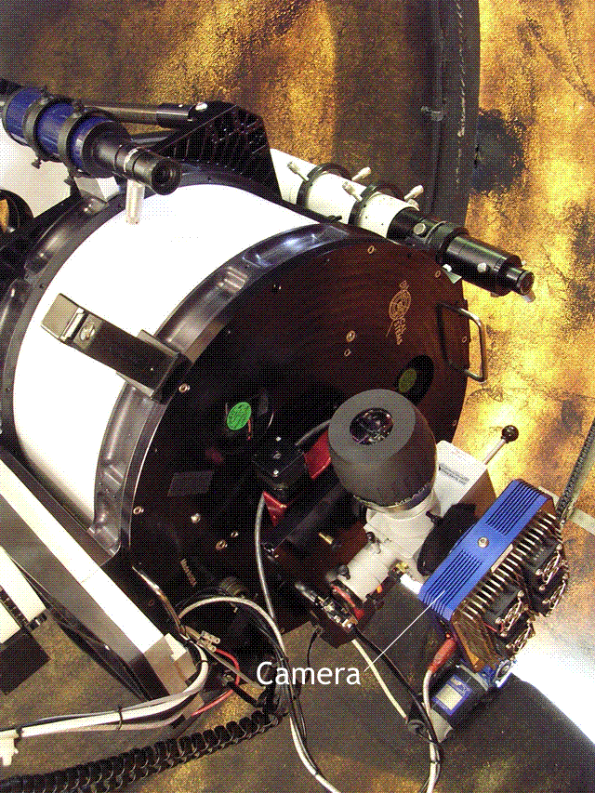
Basic Camera Concepts
For this workshop it’s important to understand these four camera concepts:
Image size
Pixel scale
ADU range
Linearity of response

Slide 18
1: Camera image size
Your camera needs to capture as wide a field as possible – 15′ or more – at the prime focus of your telescope.
My telescope at Woodridge Observatory has a focal length F = 3380 mm.
One arcmin at a focal length F is F/3438 long.
So how long (in mm) is one arcmin for that scope?
The telescope’s Apogee U13 camera has a Kodak KAF1301e chip whose width w_{c} = 20.48 mm.
So how many arcmin is its field width W?
Notes:
Camera field width W = w_{c}F/3438 arcmin, w_{c} and F in same units.
For the WO reflector, F = 3380 mm, so 1’ = 0.983 mm at prime focus.
Its Kodak KAF1301 chip has w_{c} = 20.48 mm, so the field width W = 20.8’

Slide 19
Your minimum chip size
Most chips are rectangular with an aspect ratio of ~4:3
Take the minimum desirable field width as W=15′ (arcmin).
Write down your own scope’s focal length F in mm.
Now calculate the chip width w_{c} (in mm) your scope needs to realise a W=15′ field.
Notes:
Aspect ratio is width:height.
If you know your scope’s focal length in inches, 1 mm = 25.4 in.
Rearranging the previous equation, w_{c} = 3438W/F, w_{c} and F in same units, W in arcmin.

Slide 20
2: Camera pixel scale
You just calculated the WO/U13 camera image width W = 20.48'.
What is that in arcseconds?
The DSI’s Sony chip is a pixel array 510 pixels wide by 496 pixels high.
So what is its image scale s in arcseconds per pixel? ("/px)
An image scale s ≈ 1"/px is ideal for amateur conditions. We’ll see why later.
Notes:
Pixels on a CCD chip are often called photosites – a better name as it removes various ambiguities with other uses of pixel, e.g. when photosite data is binned 2x2 into one pixel.
WO’s reflector has W = 1250". Its chip is 1280 x 1024 px, so s = 0.98" /px.

Slide 21
Your camera’s pixel scale
Your have calculated the CCD chip width w_{c} your scope needs to have a W=15′ field.
You want that chip to have 1" wide pixels
So how many pixels wide should your chip be?
Given your chip width w_{c} [mm], calculate the width of one such pixel w_{p}
[in microns µ = 10⁻³ mm].
Now you know what chip width and pixel size to look for in a camera that will match your scope.
Notes:
Note in the first question, the answer is independent of your chip width w_{c} or scope focal length F.
Remember this field width W=15’ is a minimum, so you are calculating the minimum number of pixels across for your CCD chip. A bigger W means more pixels.
WO’s Apogee U13 camera has square pixels, 16 x 16 µ.

Slide 22
Mismatch between scope and camera chip
If your scale is too small, e.g. 2"/px, use a barlow lens that will approximate a match
If (more commonly) your scale is too large, e.g. 0.5"/px,
  use an image compressor to approximate a match
  or use software binning (e.g. 2x2) ☹
Notes:
For the Jubilee/DSI system, s = 0.793"/px, which is quite acceptable. It will produce ever so slightly bloated star images – not at all a concern.
If your scale is n"/px, (n>1) you need an n-times barlow, or for n<1, an n-time tele-compressor.
Using corrective lenses is best avoided if at all possible, since they absorb light and introduce vignetting and aberrations.
Binning means that the data from a group of adjacent camera pixels (photosites), e.g. groups 2 wide by 2 high, are combined to yield one pixel of data. If you had a 1024 by 768 pixel camera and binned its images 2x2, you would get a final image on your screen (and stored in your computer) of 512 x 384 px.
Binning is undesirable because it means you have a small field width . E.g. if in the previous example you get 1" /screen pixel resolution after binning, your field width W = 512" or only 8.5'. Use a 2x image compressor instead. You are now getting 1" /camera pixel and W = 1024" = 17.0'.

Slide 23
3: Camera ADU range
Photons
Photons fall onto a camera pixel (photosite)
They generate a charge of electrons in the pixel
The charge in the pixel is measured as a binary integer – an Analog to Digital Unit
The ADU reading is output to the computer
Charge of electrons builds up inside the photosite
SINGLE PHOTOSITE ON A CCD CHIP
Charge is measured
A-D CONVERTER
A number is output
DISK STORAGE
Notes:
WO’s camera produces 16-bit ADUs. So does the DSI Pro.
Don’t settle for less that a 16-bit A-to-D converter in your camera!
A 16-bit A-to-D converter can record 2¹⁶ = 65536 levels of brightness, from 0 to 65535
0 is dead black (no light), 65535 is called the saturation level of the camera – the maximum brightness level.
A lesser A-to-D converter, e.g. 12-bit, means you can’t measure brightness differences so finely (in fact in this case it’s 16 times as coarse!)

Slide 24
What the ADU numbers mean
The ADU number output to the computer is a binary digit with a fixed maximum value.
For most cameras this is set to 2¹⁶-1 (i.e. a 16-bit integer)
  So the ADU range is 0 to 65535
  0 represents dead black, 65535 pure white
This sets a limit to the fineness with which the photometry can be done.
  If the range was 8 bits, photometry could only distinguish 2⁸ = 256 brightness levels.

Slide 25
4: Camera Response Linearity
Creation of electrons is very efficient, e.g. 0.7 electrons per green photon in WO’s Apogee camera
The charge created is strictly proportional to the number of photons entering the pixel
As the pixel nears saturation (>75% full) linearity drops off
So you have to ensure stars you are measuring are below that brightness level.
Notes:
Green = 5500 Angstroms.
Electrons per photon is called quantum efficiency.
Compare with photographic film: 1% QE, and film response is neither linear nor precisely predictable.

Slide 26
Linearity failure
Saturation level
It’s fairly simple to measure your response curve to see where it goes non-linear:
  Take exposures on a star of 2, 4, 6, 8… seconds and measure its peak intensity in each image, then draw a graph.
65535 ADU
Nonlinearity commences about here
Peak Intensity (ADU count for brightest pixel in a star image)
0 ADU
Exposure time
Notes:
Why does linearity drop off? The increased charge inhibits creating more electrons, and also electrons near the top of the pixel well can leak away.
Intensity is the total ADU count for the star (sum of ADUs for each pixel in the star’s image, roughly). More on this later. But a star’s image occupies several pixels, so the peak intensity is the ADU count of the brightest pixel in the image. This is the one that’s affected first by non-linearity.
Unfortunately for the Meade DSI pro, linearity failure sets in at 50% saturation, so you have to keep the maximum ADU value in any star you are measuring below ~32,000 ADU. This strongly limits the dynamic range of the stars that you can compare; i.e. the ratio of the brightest to the faintest star you can measure. The faintest star you can measure reliably needs to have a Signal-to-Noise ratio of 100 (see later), and that typically means a peak ADU value for the pixels in its image of ~2000 ADU. So the dynamic range is 32,000/2,000 or 16, which translates to exactly 3.0 magnitudes.

Slide 27
Equipment item 5: Guiding Equipment
Useful in order to:
  Correct residual periodic error (short period error)
  Correct for drift due to inaccurate polar alignment or drive speed (long term error)
  Correct for changing atmospheric refraction (long term error)
Four ways:
  CCD camera on guide scope
  Second, guiding, chip on camera
  Astrometric resynchronization
  Don’t bother? (assumes 1,2 good, can’t fix 3)
Notes:
How important are these problems?
Periodic error matters only if it shows up in an image – stars as lines. Usually it will show up if pe > 3".
Drift and atmospheric refraction are negligible in a given image, but after hours of images the stars may drift off the field.
Does that matter? You may lose the stars you are measuring. Incidentally MaxIm has no trouble finding stars in successive frames that drift a bit.
How good are the fixes?
Camera on Guide scope subject to changing flexure
Second guiding chip is a good approach
Astrometric resynch realigns the scope every few images – great for all but p.e. which has shorter time-scales.
If you have a good drive, don’t bother!

Slide 28
Equipment item 6: Your Computer
Nearly all imaging software is Windows™ based, so use a Windows XP computer
Get a big disk – you can collect up to a gigabyte in one night!
Get maximum RAM and fast CPU
Ensure your data cable can handle the throughput (active USB2 is a good idea)
DVD burner for archiving.
Notes:
Plenty of RAM is needed for download and disk writing in a hurry, but it’s particularly useful for image processing when you may want to have hundreds of images open on-screen at the same time.
Data cable: USB for example is reliable only over 5 metres max.
At WO, an image of 2.5 MB downloads in 1.8 seconds, via USB 2.0. During a fast series of exposures, the camera occasionally misses a command to expose and so goes idle. The fix so far is to put an active USB cable into the overly long (8 m) data line, and increase RAM to 2 GB. CPU speed is 2.8 MHz. But it’s still not quite right and I still have a lot of trouble with the camera going idle. Advice is eagerly sought!

Slide 29
Equipment Item 7 and last: Software
Software can control:
  Telescope mount (target acquisition, guiding, error correction)
  Focusing via an electro-mechanical focuser
  Camera (temperature, image acquistion, …)
  Image processing (inspection, calibration, photometry, …)
You need software to handle all these.
Some software specializes, e.g. camera control only, or image processing only.
MaxIm does them all.
Notes:
Telescope mount control and focusing are not necessary, but can save a great deal of time and raw nerves.

Slide 30
More software – optional!
A planetarium program that links to scope control
Automatic dome rotation saves you getting up through the night (so does a roll-off roof!)
A cloud/rain sensor linked to the dome/roof shutter motor gives peace of mind
A telescope mount modeller maps the inevitable pointing errors in your scope and mount, ensuring the pointing software always points the scope dead accurately every time.
Notes:
WO uses TheSky 6 planetarium software from Software Bisque. This and MaxIm are both linked to a “virtual telescope” called POTH or Plain Old Telescope Hub. This in turn links to the MaxPoint mount modeller from Cyanogen Inc, the makers of MaxIm, which drives the telescope mount.
WO is installing MaxDome dome control software from Cyanogen, and uses the Boltwood Cloud Sensor from Cyanogen.

Slide 31
Summary of Imaging Equipment
Astronomical CCD camera
  non-colour & non-anti-blooming
  thermostatically controlled cooler
  16-bit ADU range
  giving a 1"/px image scale on your scope.
Guiding gear depends on mount quality
Windows computer, as powerful as you can afford
Software to control:
  Mount, guiding and focusing (ideally)
  Camera, image processing and photometry (necessary)
Next we will look at handling images in MaxIm; and at errors in images and how to remove them.

Slide 32
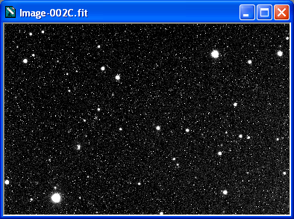
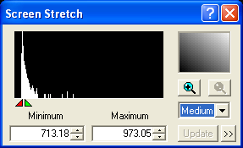
Exploring images in MaxIm:
Handling contrast
In Maxim menu File>Open, open from your desktop Raws\Image002.fit
Open Screen Stretch window from View menu
Change its contrast settings, then back to Medium
Move the min/max marker carets, then reset contrast settings to Medium
Contrast settings
Min/max marker carets
Notes:
Contrast settings: Low, Medium, etc. provide various levels of image contrast suitable for different purposes. Note as you change these settings the Min/max marker caters move in the Histogram pane.
This pane shows you how many pixels in the image (vertical scale) have a particular ADU value (horizontal scale). It is an intensity histogram. The horizontal scale goes from 0 ADU on the left to 65535 (saturated) on the right. It is measuring the image pixels as recorded on disk, as output by the A-D converter.
The marker carets are showing you the limits of what’s visible on-screen. The left caret tells you what ADU value is being rendered as black on-screen, and the right hand caret ditto for white.

Slide 33
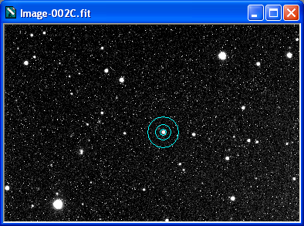
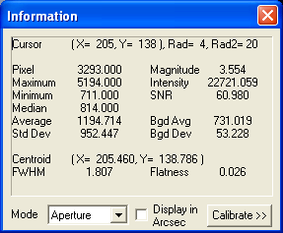
Image information
Open the Information window from View menu
Set Mode to Aperture, ensure Display in Arcsec is not checked.
Move mouse cursor over image (VW Hyi is marked here). It turns into a 3-ring measuring aperture.
Notes:
The Info window shows data from the the innermost of the three rings

Slide 34
The information is photometry!
Info window top pane – cursor and its rings
Left pane & Centroid pane – star data from inner ring
Bgd pane – data on sky brightness from outer ring
Now mouse over the bright star bottom left of your image!

Slide 35
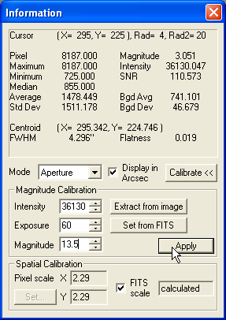
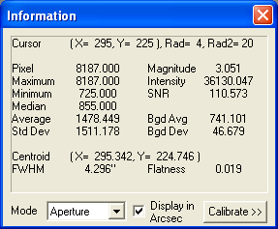
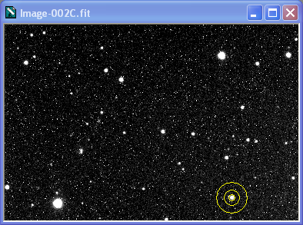
Magnitude and Intensity
Magnitude value is crazy!
Click Calibrate
To measure the intensity: click Extract from Image then centre the ring cursor on the star shown and double-click
  Cursor stays fixed, rings turn yellow
  This star is known to be mag 13.5
In Magnitude field, type “13.5”, click Apply
  Magnitude conversion is set.
Notes:
MaxIm needs to be told how to relate the measured intensity of a star image to its magnitude.
Intensity = total ADUs of all px in the star aperture – bkg ADU level.

Slide 36
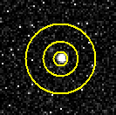
The measurement circles
MaxIm measures intensity of a star image
  Hence the small inner star aperture circle
But background sky level must be measured and subtracted to get the star’s actual intensity.
  Hence the surrounding sky annulus
Why the gap between the two?
  To avoid the star’s light contaminating the sky annulus.
Notes:
The initial star intensity reading s₁ is the sum of the ADUs of all the n pixels in the star aperture.
The sky background b (per pixel) is the mean of the ADUs of all the pixels in the sky annulus.
The final star intensity s subtracts from s₁ the sky background in the star aperture, i.e. nb ADUs.
That is, s = s₁ – nb.
In practice, b isn’t the mean; a fancier algorithm is used to reject the contribution of any stars in the sky annulus.

Slide 37
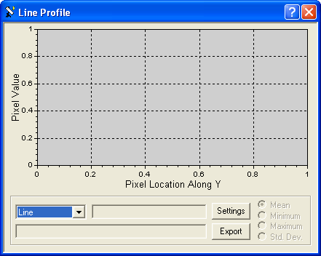
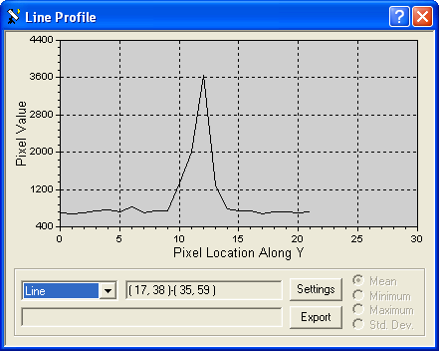
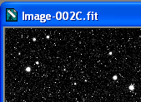
Star Profiles
In the View menu, open Line Profile Window
In the pull-down list box, set the profile type to Line
In the image, drag a short line through the middle of a star to see its profile
Try that on the bright star bottom left!
Set the profile type to Area and draw a small box around a star.
Notes:
Note the unnatural flat top to the profile of the bottom left star. That is at the saturation value of 65535.

Slide 38

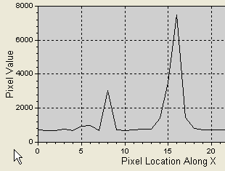
Profiles and FWHM
Try dragging the line through two stars of very different brightness – right through the middles.
Different heights, but similar shapes
All profiles have about the same width halfway up
That width is called Full Width at Half Maximum
Measure the FWHM of several stars (Information window, Aperture setting, measure in pixels) – note down a rough average.
Notes:
I get a mean FWHM of ~1.7 px

Slide 39
Think FWHM!
The FWHM of stars on an image (in arcsec) tells you your system’s actual resolution.
To measure this, we must tell MaxIm our resolution in arcsec per pixel
In the Information window, click Calibrate then click Set from FITS.
Display in Arcseconds, and re-measure the FWHM of VW Hyi.
  What do you get?
  Why is the resolution in FWHM so much worse than the scope’s theoretical resolution?
Under amateur conditions, expect an FWHM of 2" - 3"
Notes:
FITS refers to header data in the image file, which includes the system’s resolution.
The value should be 2.29 "/px (the image is binned 2x2 – unbinned resolution is 1.14 "/px).
Avoid measuring the two saturated stars.
I get ~4" mean FWHM.

Slide 40
FWHM and aperture radii
Now we need to measure in pixels
In the Information window, un-tick Display in arcsec.
In the image, measure the FWHM of some stars
Experience and theory says:
  Set the radius of the star aperture to 2 or 3 x FWHM. (Use pixels not arcsecs.)
  What’s that for you?
  Gap width should be 2 to 3 x FWHM at least
  Sky annulus width should also be 2 to 3 FWHM at least
Right-click in the image frame and Set the three figures.
Check VW Hyi’s magnitude (Information window). Write it down.
Notes:
I get a mean FWHM of ~1.8 px.
So I’ll set the aperture radius to 5 px, the gap width to 5 px, and the annulus thickness to 9 px.
These radii can be varied, e.g. if there’s an unwanted star right next to the star you are measuring, adjust the gap width so it is in the gap.
Also, try to avoid having stars in the sky annulus – they can give a false sky background reading, even though most algorithms will discount the stars’ contribution.

Slide 41
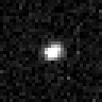

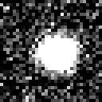
FWHM and pixel scale
For photometry, you want 2-3 pixels across an FWHM
  Less makes for pixelated stars & inaccurate readings due to gutters between CCD pixels
  More makes stars look blurry
Amateurs typically have 2" - 3" FWHM
So an image scale of
1"/CCD pixel is ideal.

Slide 42
The FITS header
How did MaxIm know the image scale, so it could convert from pixels to arcsecs?
It’s all in the image’s FITS Header (Flexible Image Transport System).
Select the open image in MaxIm, and in the View menu, click FITS header window.
Have a look, then close it.

Slide 43
Signal and Noise
The “salt-and-pepper” specks on this image are unwanted noise.
This noise obviously will create errors in brightness measurements – noise is a source of photometric error
Notes:
So if you have SNR=200, the precision of your magnitude estimate will be 1/200 mag. In practice as well as theory, other factors will
somewhat worsen that precision.

Slide 44
Measuring Noise Levels
Check VW Hyi’s SNR (Signal to Noise Ratio – Information window). Write it down.
  Aim at SNR ≥ 100 on target star for good results (lengthen the exposure time if necessary)
  Measurement precision ≈ 1/SNR (in mags).
Check VW Hyi’s background average (sky brightness) and standard deviation (measured in ADU). Write it down.
  That Std. Dev is a good indicator of noise level.
Notes:
To measure the SNR, ensure MaxIm’s Information window is in Aperture mode, then carefully centre the aperture rings over the star image.
The Info window then shows the SNR for that star. It will also show the mean and SD for sky brightness, measured in the outer ring. The SD basically says not to trust any star brightness measure to within that number of ADU per pixel in the star image.
Try some other stars; the fainter they are, the smaller their SNR.

Slide 45
Beating down the noise
Beating the noise gremlin is the main occupation of the photometrist!
Any signal will inherently have a level of noise associated with it called Poisson noise;
The only way to beat down the Poisson noise is to have a stronger signal;
  So if you’re measuring SNR < 100 on a target star, lengthen the exposure time.
Notes:
The Poisson noise associated with a signal is always proportional to the square root of the signal strength.
So if you take an exposure four times as long, you’re doubling the Poisson noise. (√4 = 2)
But you’ve quadrupled the signal, so altogether the SNR has doubled.

Slide 46
Three other Sources of Error
Most of that salt-and-pepper background we saw is due to pixel-by-pixel differences in dark current emitted by the camera pixels – not to Poisson noise.
Also, different camera pixels have different sensitivity to light falling on them.
A pixel will record a certain ADU level, called bias, even for a zero-length exposure.

Slide 47
Source (1) of Error: Dark Current
Each camera pixel creates its own charge, at its own rate, even when light is not falling on it.
  This current is very sensitive to temperature.
  The current is constant, so the charge accumulates strictly proportionately to the exposure time
  The charge is added to the charge created by the photon flux
    So we need to subtract it to find the charge due to the light.
Notes:
The charge creation rate (a current: electrons per second) stays the same for a given camera pixel for days or weeks.
For a given pixel, ADU ∝ electron charge
But electron charge = charge due to photon flux + dark charge
So ADUs due to photon flux = total ADUs – ADUs due to dark charge.

Slide 48
Removing the Dark Charge
Minimize by running the camera at as low a temperature as possible
Also, take a dark frame (camera shutter closed) of the same exposure time as the image of the stars (light frame)
  It records just the dark charge accumulated over that exposure period
  Use MaxIm to subtract it from the light frame. Called dark subtraction.

Slide 49
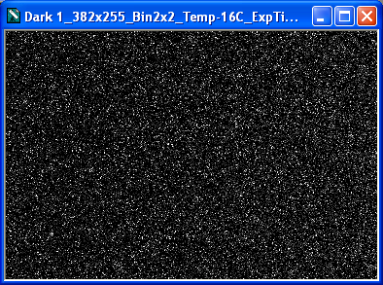
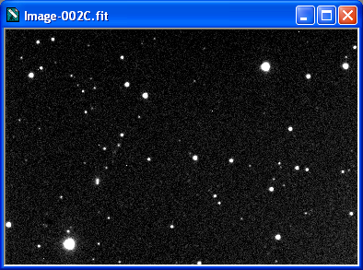
Dark subtraction
-
=
Notes:
Note the salt-and-pepper in the dark frame looks very like noise, but strictly it isn’t, since it is reproducible. One dark frame has the same salt-and-pepper as the next one you take.
However dark frames have Poisson noise, since they are a signal. That’s why we expose and combine lots of dark frames, effectively increasing the signal greatly with respect to the noise. (16 dark frames combined with have four times the SNR of a single frame: √16 = 4.)

Slide 50
Source (2) of Error: Sensitivity
Each pixel has a different sensitivity to the photons hitting it
Some pixels will be shadowed by dust specks or by vignetting – lowering their effective sensitivity.
Pixel sensitivity is usually constant long-term, but dust can change effective sensitivity nightly.
Notes:
(Strictly this is not noise but distortion.)

Slide 51
Flat Field Theory
Map effective camera pixel sensitivities by taking a flat field: an image of an absolutely uniformly bright field.
The resultant image is not uniformly bright, as it maps the variations in the effective sensitivities of the camera pixels
So divide a light frame by that flat-field image, pixel by pixel, and you cancel out the differences in pixel sensitivities.
Notes:
Here’s the theory of why we divide a light frame by flat-field frame:
In each camera pixel of that flat-field image:
charge = photon flux x effective sensitivity
(we say effective remembering it may be shadowed, etc.)
If the field is uniform, the number of photons that should hit each camera pixel is the same
So the charge in each camera pixel is a direct measure of its effective sensitivity.
Hence the ADU count of the stored pixel is a direct measure of the camera pixel’s effective sensitivity:
ADU count of flat-field pixel ∝ effective sensitivity of corresponding camera pixel
So we now know the sensitivity of each camera pixel.
Hence we can correct each pixel of a light frame by rearranging the above equation and express as ADUs instead of charge:
photon flux for light frame camera pixel ∝ ADU count of that pixel / effective sensitivity of corresponding camera pixel.
That amounts to
photon flux ∝ ADU count of light frame pixel / ADU count for that pixel in the flat-field image
That’s why we get MaxIm to divide the (dark-subtracted) light frame by the (dark-subtracted) flat-field frame.

Slide 52
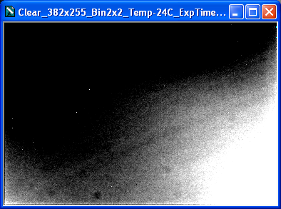
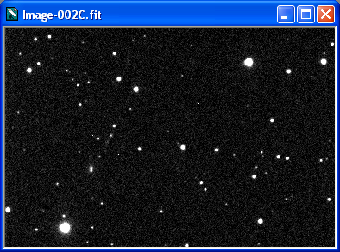
Flat-fielding
/
=
Notes:
Doubtful if flat-fielding makes a difference? Measure background and standard deviation in bottom right corner, before and after.

Slide 53
Taking Calibration Frames: Darks
Removing sources or error is called Calibration.
Take 16 or more dark frames, interspersed with the light frames you’re taking.
  All frames, dark and light, should have the same exposure time.
  All frames should be taken at the same temperature.
  We will see later how to automate this in MaxIm
  MaxIm keeps the shutter closed when taking a dark frame
  Note these are raw darks.
Average the raw darks in MaxIm (Process menu, Set Calibration) to make a master dark.
  This will have far less noise than the raw darks.
Notes:
In practice, the darks need not have the same exposure time as the light frames they are destined for. Since they accumulate charge at a constant rate, it is easy for MaxIm to scale them appropriately when subtracting them from the lights.
To some extent, the same holds for small temperature differences: this can be compensated by scaling. But you have to work out empirically what that scale factor is first.

Slide 54
Taking Calibration Frames: Flats
Take your flats on the same night as your light frames.
  Expose for as long as you can without reaching the non-linear ADU counts.
  Exposures shold be longer than 1 second, to avoid non-uniformities from shutter movement.
  Take 16 or more frames and average them in MaxIm to reduce noise, making a master flat.
Notes:
Unlike darks, you can’t trust flats to last very long, due to dust settling and making shadows on the CCD. So unless you have a closed tube and can show there is no difference in flats from night to night, you must take them nightly.

Slide 55
The Uniform Light Source
What is your uniform light source for flats?
  Image the twilight sky
  Or, illuminate a white board on your dome or wall with tungsten or halogen lamps, and put a white translucent diffuser over the telescope’s open end pointing at the board
  Or invent a fancy light box to stick over the mouth of the scope.
All this can be tricky – you need to invent tests to prove you have imaged a truly uniform light source!
Notes:
Problems with sky flats:
The sky gets darker, and
It’s unevenly bright, and
There will be stars there, and
It’s usually dinner time, or it was cloudy at sunset and cleared up later.
Problems with dome and light-box flats:
Lamp colour doesn’t match star colour (halogens are good, fluoros must not be used)
It can be hard to stop gradations in the light source, even after diffusing.

Slide 56
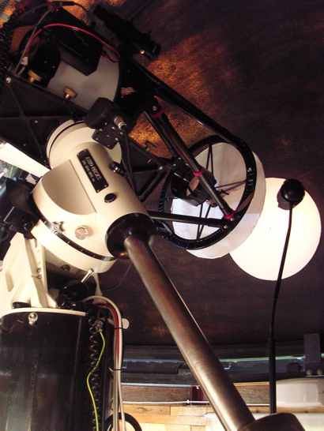
This is the dome-board flat-fielding setup formerly used at WO:
White disk on dome
Illuminated by halogen lamp
Diffuser in front of scope
Notes:
My test for uniformity:
Take a flat, move the lamp to the other side, take another flat.
In MaxIm, subtract one flat from the other. The result is a uniform frame with <2 ADU variation.
The best test:
Image a pair of bright stars that are close to each other – say 2 arcmin apart. Image them right in the middle of your field.
Measure their brightness difference in MaxIm.
Now shift the scope a bit so the pair is in the top left of the field and repeat. Shift again so they occupy the nine positions of a 3x3 grid in the field, and repeat.
All nine measurements should be the same to within your errors of measurement.

Slide 57
Flats need Dark-Subtraction
Flats like light frames need dark-subtraction!
  So you’ve got to take darks for them, of same exposure time and temperature
  That can double the time you spend each night getting your flat-frames.
If you change your temperature or exposure time for flat frames, you must take darks for each time/temp combination!
If you are using filters, you must take flats through each filter.
So when do you get time to take your light frames? ☹

Slide 58
Saving time on Calibration
Take a library of dark frames one cloudy night!
  At WO I take them at 4° intervals:
  -24° to -40°.
  That covers the summer-winter range of temperatures to which I can cool my camera.
  I take 16 of each, 120 seconds long.
  Then I average them in MaxIm to make masters with less noise than the raws.
  Then I store the masters for future use.
Notes:
Dark masters are easily good for six months
But check occasionally by taking some more, then subtracting from a library dark to see if there’s a change.

Slide 59
Using Library Darks
Suppose I take a 60 s light frame.
I have a 120 s library dark (exposed at the same temperature).
Dark charge accumulates proportional to time.
So I can apply the library dark to the light frame by halving the ADUs of each pixel in it!
Unfortunately, this theory overlooks another source of error…
Notes:
In general, suppose your dark master has an exposure time of d s, and the light frame of ℓ s, and you ask MaxIm to perform the dark subtraction. It will first multiply the dark frame ADUs by ℓ/d, then perform the dark subtraction.

Slide 60
Source (3) of Error: Bias Charge
A CCD pixel delivers a small charge even when not exposed – called its bias.
Camera manufacturers usually add a pedestal of about 100 ADUs to it.
So a 120 s dark frame will comprise bias charge + 120 s worth of dark charge
And a 60 s light frame will comprise bias charge + half as much dark charge + the sky/star data.
Notes:
In terms of ADUs for a stored pixel:
Total ADU value = Bias ADU + Dark-charge ADU + sky-star ADU.

Slide 61
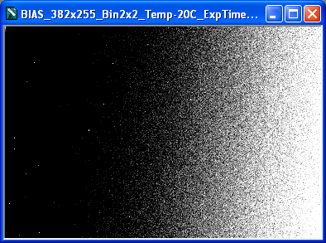
The Bias Frame
A 0-time exposure will give you a picture of your camera’s bias.
  Take 16 bias raws at a low temperature and use MaxIm to get a bias master
Biases are very stable, over many months

Slide 62
The Whole Calibration Story, part 1
BEFORE BIAS SUBTRACTION
Dark Master
To dark-subtract from a target frame using a library dark master:
  Subtract the bias master from the dark master and the target frame.
Now the dark master has only dark-charge ADUs.
Bias + Dark 120 s
Target Master
Bias + Dark 60 s + Light data
Bias Master
Bias
AFTER BIAS SUBTRACTION
Dark Master
Dark 120 s
Target Master
Dark 60 s + Light data
Notes:
Grey frames indicate we don’t know the mix of their component data.
The target frame can be a flat-field frame or a light frame.
Dark master ADU = Bias ADU + dark-charge ADU
Light frame ADU = Bias ADU + dark-charge ADU + ADUs from the photon flux.
Step (1) removes the bias.

Slide 63
The Whole Calibration Story, part 2
AFTER SCALING
  Scale the dark frame to match the exposure time of the target frame, and subtract it.
Now the target frame’s ADUs are due only to the photon flux.
But they are still factored by the pixel sensitivity.
Dark Master scaled to 60 s (halved)
Target Master
Dark 60 s + Light data
AFTER DARK-SUBTRACTION
Light data

Slide 64
The Rest of the Calibration Story
Thanks to bias- and dark-subtraction of the light frame and flat-field frames, these now contain only light data:
  Light frame has just the data from the sky
  Flat frame has just a sensitivity map from a uniform light field.
Consider a flat-frame pixel whose ADU value is 125% that of the average ADU value for the entire flat frame.
  It’s 125% more sensitive than the norm.
So we divide the corresponding light-frame pixel by 125%, to get what brightness it should have.
Notes:
For the bias- and dark-subtracted light frame, in each pixel
ADU value ∝ photon flux x effective sensitivity.
Divide out the effective sensitivity using the flat master, and we are left with
ADU value ∝ photon flux

Slide 65
Flat-fielding Example
Flat-field frame Master
Sensitivity level of this pixel is 125% of…
…average sensitivity level
Light frame
So before dividing, ADU level of the corresponding pixel is 125% of…
…the correct light data level, obtained by dividing.

Slide 66
How MaxIm Calibrates
Maxim will follow the procedure just described:
Start with a Bias master B, Dark master D, Flat-field master F, and Light frame L.
Subtract B from the rest pixel-wise.
Scale and subtract D from F and L pixel-wise.
Divide L by F pixel-wise, with F normalized to its mean ADU as 1.0.

Slide 67
Session Summary
In this session you:
  Used MaxIm to get information about images
  Learned about measurement circles and how to set them based on star FWHM
  Studied noise and the three main sources of image errors and the principles behind their removal
  Learned about taking calibration frames (bias, dark, flat).
In the final session we will:
  see how MaxIm does time-series imaging
  calibrate images to remove the three noise sources, and
  do some photometry.

Slide 68
Exposure time
There will be 3 stars in the field to choose and measure:
  Variable V
  Comparison star C (explained later)
  Check star K (explained later)
Must check at least the first two on a test image
  This sets a maximum exposure time.
Notes:
We don’t want V and C to be in the non-linear range of the camera (see earlier). K is usually fainter.

Slide 69
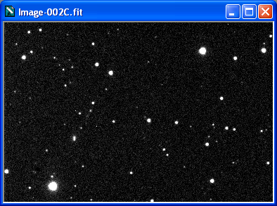
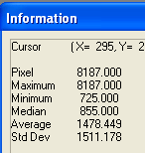
Checking saturation
Here’s the V and C
Check their Maximum ADU count in the Information window.
These are 60 s exposures
Often, you can expose longer but don’t want to.
VW
135
Notes:
Tracking accuracy can impose an upper limit on exposure time – you want your star images to stay circular.

Slide 70
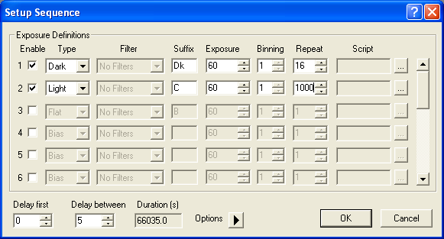
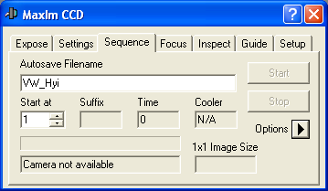
Take the exposures
In MaxIm’s CCD Control window (from View menu), you go to the Sequence tab
Give the images a name
Click Options button and select Setup Sequence
Enter settings,
click OK, click
Start, and
you’re running!

Slide 71
Now you’re OK to calibrate
You have taken your light frames overnight
On a cloudy night you have taken:
  Dark raws at different temperatures
  Bias raws
  Flat raws (if you can trust the stability, otherwise take these on the night you take the light frames)
You have used MaxIm to make masters of these and store them in a Calibration Masters folder
  (We will not here study how MaxIm makes masters – read the online documentation!)
Notes:
Your raw images for this workshop should be in RAWS on your desktop right now;
And your three calibration master frames should be in CAL FRAMES on your desktop right now.

Slide 72
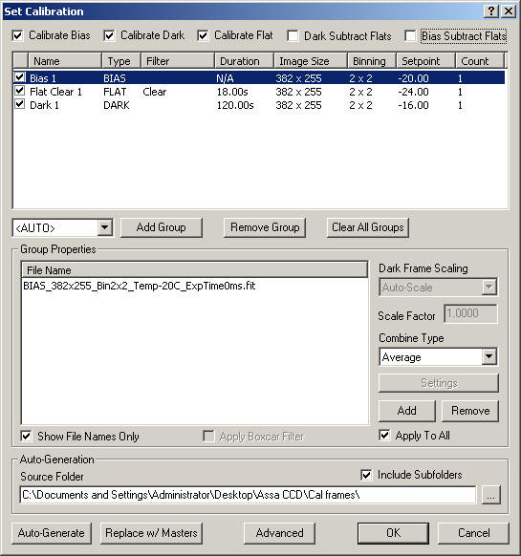
Let’s calibrate an image! - preparation
In the Process menu, open Set Calibration.
Use the … button to set the source folder to Cal frames on your desktop, then click Auto-Generate.
Ensure the first three calibration operations across the top (only) are ticked.
Ensure the three calibration frames are ticked.
Click OK.
Notes:
This window tells MaxIm how to calibrate an image, and with which calibration frames.
By ticking the first three boxes across the top, MaxIm will do bias removal, dark subtraction (with scaling) and flat fielding on light frames.
By ticking the remaining two, MaxIm will bias- and dark-subtract the flat frame, as well. However our flat master has already been bias- and dark-subtracted, so we will not tick these fields.

Slide 73
Let’s calibrate an image – do it!
In MaxIm, open Image002.fit
  Write down the SNR for VW Hyi (Information window)
In the Process menu, select Calibrate.
  How did the image change?
  How does the SNR for VW Hyi compare now? It should be very much better!
Close the image without saving it!

Slide 74
Calibrating all the images
We have 100 images to calibrate
In MaxIm close any open windows, then from the File menu open Batch Save and Convert. The Batch Save and Convert window opens.
Click Select Files.
In the selection box that opens select all the files in Raws, then click Open. The selection box closes.
Tick Perform calibration.
In the Destination panel click Path. The Select Folder window opens.
Select the desktop folder Calibrated, then click OK. The Select Folder window closes.
Click OK and wait a few seconds – it’s all done.
Open one of the images in Calibrated to check, then close it.
Notes:
This process selects all the raws, calibrates them, and puts the calibrated images into the Calibrated folder; leaving the raws as they were.

Slide 75
Preparing for Photometry
The Information window does photometry, but it’s “quick and dirty”.
MaxIm has a photometry routine designed to handle a series of any number of images of the same field. Use it instead.
First we must:
  Check all the images
  Set the photometry aperture circles.

Slide 76
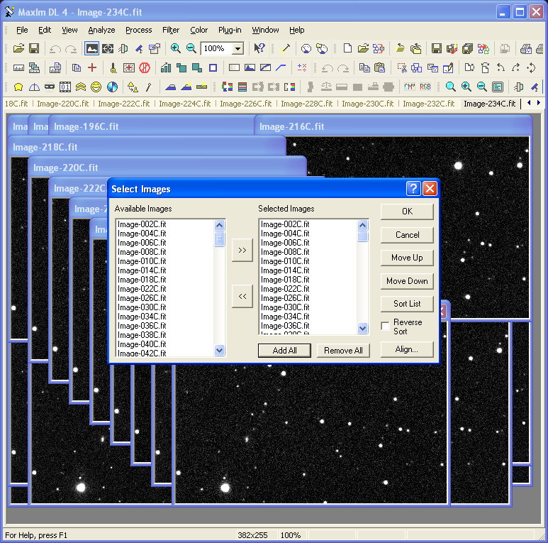
Checking the images
In MaxIm’s File menu, click Open and open all the images in the Calibrated folder.
In the View menu, click Animate, Add all, and OK.
  The Animate box opens.
Notes:
If your computer has very limited memory, it may not be able to open all 100 images. In that case omit this step.

Slide 77
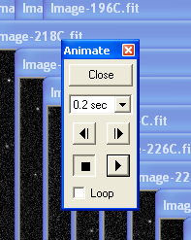
Checking the images
Set the timing to 0.2 seconds, click the right arrow, and watch the animation carefully.
  Look for bad images (trailing, bad image shifts, clouds, etc.) and note their numbers.
  (There are none in this image set.)
Close Animate
(If there were any bad images, close all the images, then delete the bad ones from the Calibrated folder, and re-open the ones left.)
You are now ready to do photometry on the open images.

Slide 78
Setting the Aperture Radii
Open the calibrated Image002.fit.
With the Information window set to Aperture, measure the FWHM of 3-4 medium stars (in pixels) and get a rough average.
Right-click in the image and in the context menu that opens:
  Set aperture radius to 2 or 3 x FWHM (4 px)
  Set gap width to the same (4 px). It can be more
  Set annulus thickness to the same (4 px or more).
Notes:
I get 1.5 px as the average.

Slide 79
How photometry works
MaxIm will use the photometry circles to measure the intensity of the VW Hyi star image.
  Remember it calculates the background sky level per pixel in the outer annulus and subtracts that from the intensity of pixels in the star circle.
However to do a good job, it needs to compare that measurement with the same one done on another, constant, star in the same field, the comparison star.

Slide 80
Finding a comparison star
You can use any other star if you’re brave enough, but ideally it:
  Will be as bright as the variable, or a bit brighter
  Will be near the variable
  Will be of a similar colour to the variable
Choose the comp star using a planetarium program that lists star colour indices, or better:
Use an chart from the American Association of Variable Star Observers…

Slide 81
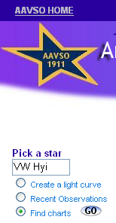
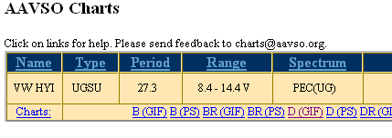
AAVSO Charts
Go to www.aavso.org
On the home page, top left, type in VW Hyi, choose Find charts, click Go.
On the page that opens, click the largest scale chart available (highest letter, usually D)
Save the chart that opens, or print it.
While you’re there, join the AAVSO!

Slide 82
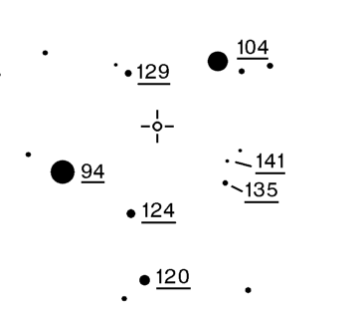
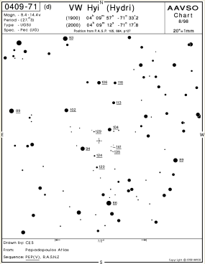
Orient the chart!
Good idea to orient your camera so north is up.
We will choose 135 as the comp star.
VW
135
Notes:
135 means its officialy listed magnitude is 13.5. Decimal points are omitted in case you think they are stars.

Slide 83
We also need a check star!
What if the comparison star C is a variable?
We measure another star, as well as the variable V, with respect to C.
It’s called the check star, K.
If K shows signs of varying we are in trouble:
  Either it or C (or both) must be variable.

Slide 84
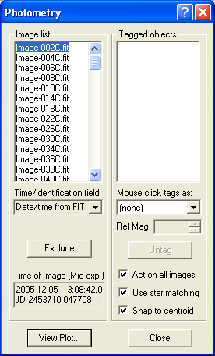
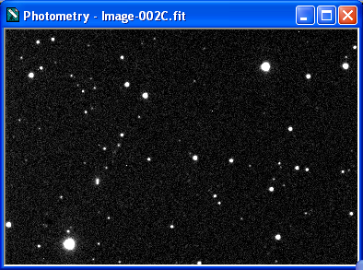
Let’s do the photometry!
In MaxIm, you should already have all the calibrated images open.
In the Analyze menu, click Photometry.
Ensure all three checkboxes are ticked.

Slide 85
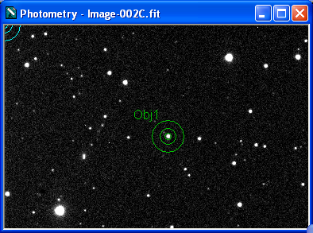
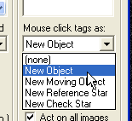
Mark the variable
In the Mouse click tags as list box, select New Object
Now click on VW Hyi in the Photometry window
  The aperture circles appear, and the star is marked on all images as Obj1

Slide 86
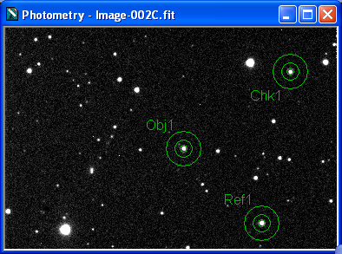
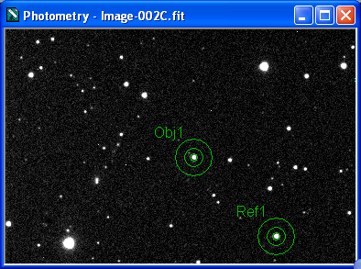
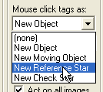
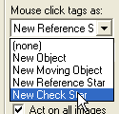
Mark the Comp & Check stars
Use the same procedure to mark these two stars:

Slide 87

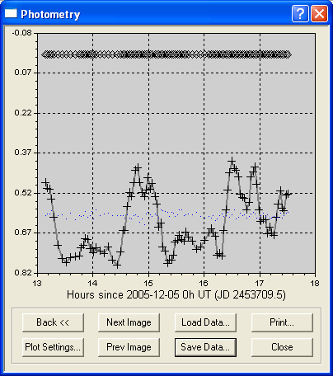
Voilà
Click View Plot
  You can pretty it up using Plot Settings
Click Save Data and save the results as Data.csv on your Desktop.
Ref1
Obj1
Chk1

Slide 88
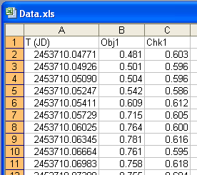
Have a look at your results.
Open data.csv in Excel or Notepad.
Each line shows the Julian date of mid-exposure, and the magnitudes of the stars relative to C as mag. 0.0.

Slide 89
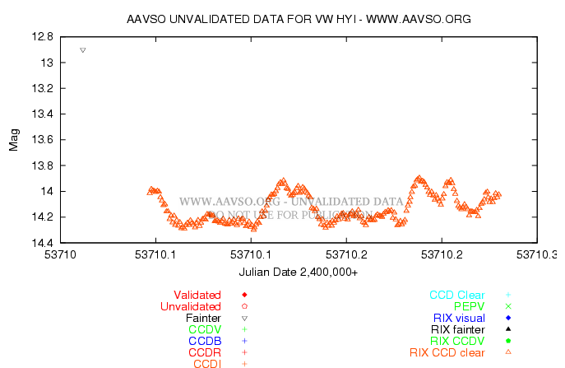
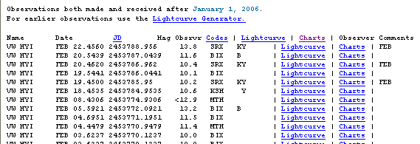

Submitting to AAVSO
First, join AAVSO: www.aavso.org
  You will get an observer code. I’m RIX
Use their WebObs to submit your data file online
Then use the Quick Look File to compare recent observations by all observers
Use the Light Curve Generator to plot everybody’s data

Slide 90

Explore the AAVSO website
Articles on many individual variables including VW Hyi.
Descriptions of all the different types of variable.
Online observing manuals, including CCD.
Sophisticated access to by far the biggest variable-star database in the world.
Info on specialised observing programs.

Slide 91
Center for Backyard Astrophysics
CBA (http://cba.phys.columbia.edu/) runs monthly collaborative observing programs on cataclysmic variables for CCD amateurs.
  This VW Hyi work was for the CBA
  Join their email list, do a time series on the current program star, email the data.csv file to CBA – it’s that easy.
  Send it to the AAVSO too!
Notes:
CBA actually request a simplified version of what Data.csv contains, and as a .txt file. However if you’re familiar with the basics of Excel, it’s easy to massage the .csv file in it to their requested format.

Slide 92
More specialised programs for time-series CCD work
Asteroid rotation periods - Brian Warner Colorado, USA: http://www.minorplanetobserver.com/
Exo-planet transit detection
http://www.transitsearch.org/
Eclipsing binaries, Delta Scutis, RR Lyraes – any fast-changing star has a web-enabled observing group. Just browse!
These programs are all pro-am.

Slide 93
Other types of CCD photometry
BVRI filters to get colour data
  Requires careful comparison with stars with known
  B-V etc. colour indices
  Big AAVSO program to provide this data for comp stars in the same field as the variable – join up!
All-sky Photometry
  To measure colour data for stars, you must in the end compare them with “standard stars” elsewhere in the sky
  Tricky, since the apparent colour of any star changes with altitude!
Snapshots (not time-series)
  On slowly varying stars – one snapshot a night, or week… usually with BVRI filters
  Colour work may be all-sky, or you might be lucky and have same-field comp stars with accurate colour data.

Slide 94
Online help on CCD photometry
Famous online textbook by W. Romanishin: http://www.observatory.ou.edu/wrccd4a.pdf
Bruce Gary has a lot of tutorials on
http://brucegary.net/
BAA’s tutorial: http://www.britastro.com/vss/ccd_photometry.htm
Join AAVSO email groups & ask dumb questions!
http://www.aavso.org/publications/email/
In the Southern Hemisphere, also join the Austral Variable Star Observers Network & do the same! http://groups.yahoo.com/group/AVSON/

Slide 95
Books on CCD photometry
AA Henden & RS Kaitchuk, Astronomical Photometry (Willmann-Bell, 1982) is the most authoritative, but the technology is photoelectric photometry (PEP). Being updated.
Brian Warner, Practical Guide to Lightcurve Photometry & Analysis (self-published 2003, see http://www.minorplanetobserver.com/) is a mine of practical info, but is oriented towards his photometry software, Canopus.
DS Hall & RM Genet, Photoelectric Photometry of Variable Stars (Willmann-Bell 2nd ed 1988) like Henden & Kaitchuk is very thorough on principles, observing, and analysis, but technology is PEP. Excellent for amateurs.

Slide 96
General books with chapters on photometry
  P Martinez & A Klotz, Practical Guide to CCD Astronomy (Cambridge, 1998)
  Steve Howell, Handbook of CCD Astronomy (Cambridge, 2000)
  R Berry & J Burnell, The Handbook of Astronomical Image Processing (Willmann-Bell, 2nd ed. 2005). Comes with the much-loved AIP software, ver. 2.0.
Notes:
Martinez & Klotz is rather hardware and software oriented, and quite thorough.
Howell is the standard reference, and is most readable. Quite a small book.
Berry & Burnell is an extensive and patient introduction; well worth reading again and again.

Slide 97
Your future when you leave here
Check your equipment for suitability (Session 1).
  OK? Proceed to doing photometry
  While doing the following, join AAVSO, buy some books, EXPLORE ONLINE, learn!
Get onto CBA email list, try a time-series on its current southern target
  Worries, problems, not sure how good? Ask on an email group, or another photometrist.
Then take the plunge, submit some results!
YOU’LL NEVER LOOK BACK!

Slide 98

And as they say at Woodridge Observatory:
CARPE NOCTEM!

